Slide 1
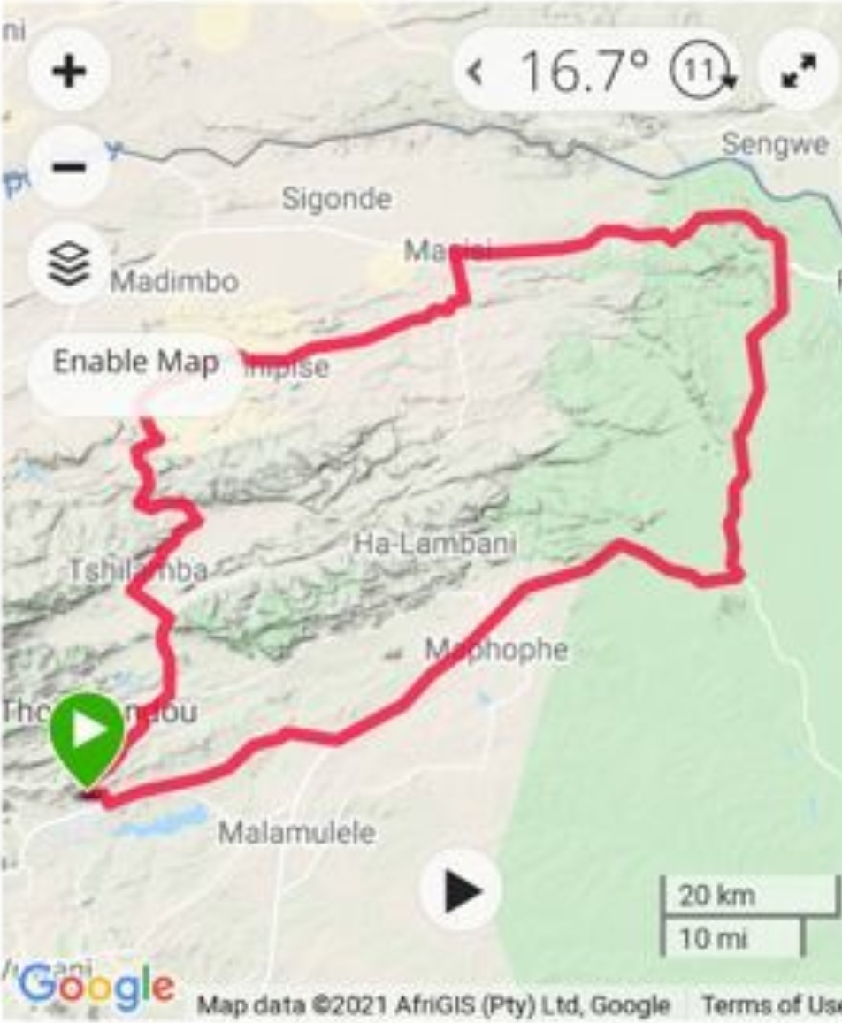
ROYAL KRUGER BAOBAB ROUTE

Slide 2
ROYAL KRUGER BAOBAB ROUTE
BACK GROUND
Royal Hills Lodge and spa is a 4 stars graded Lodge located in a very quite suburb less than 5kms from Thohoyandou Town in Limpopo. The lodge is located +-60km away from the Kruger National Park via Punda Maria gate. The lodge is about 5.8kms away from Thavhani Mall, a shopping hub for the locals and for people coming from as far as the Neighboring Zimbabwe, whereas Phiphidi Waterfalls is only 12kms away.. The lodge has a fully fledged Health spa, a Restaurant, 10 Rooms comprised of a Presidential Suite, Executive rooms with Jacuzzi and standard Rooms. If you ever asked yourself about who visits the Lodge?
The lodge has been used mainly by business travelers, but we have seen its potential to also accommodate leisure travelers.

Slide 3
The lodge is ideal for both business and leisure travelers. This is a perfect venue to celebrate anniversaries, honeymoons and other special events such as Valentines, Mother’s day, Father’s day etc.
People who visit Vhembe for business reasons will also have a comfortable stay at the lodge.

Slide 4
WHAT WE ACHIEVED
The lodge went on to do the following to accommodate leisure travellers:
Build a Fully fledged Health Spa,
A restaurant and a Bar.
Installed outdoor Jacuzzis (Executive Rooms) and
Developed a Self Drive Travel Route.
Both leisure and business travelers can enjoy this benefits.

Slide 5
ABOUT THE ROUTE
Royal Kruger Baobab Route stretches from Thohoyandou along the Punda Maria road into the Kruger National Park.
The Route proceed inside KNP and exit via Pafuri Gate into Masisi, straight to the less travelled off road towards Tshipise Sagole, back to Thohoyandou via Makonde, Sibasa road.
The Route is +-275 Km long

Slide 6
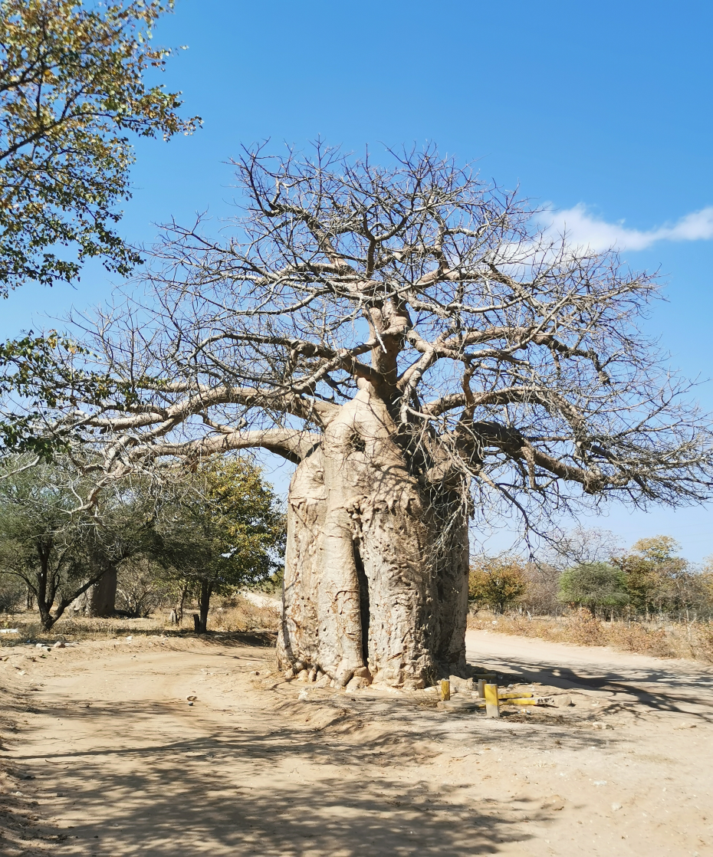
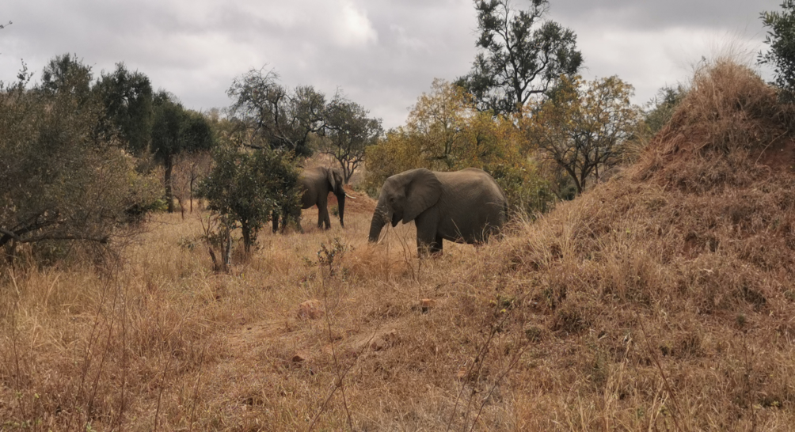
ORIGIN OF THE NAME

Slide 7
AIM AND OBJECTIVES
The Route was developed to:
Encourage travellers to spend more days at the Lodge
To directly link the lodge with attractions and activities in the Area
To encourage Coopetition instead of competition by working together with potential industry competitors found along the route.

Slide 8
ACTIVITIES AND ATTRACTIONS ENROUTE
Morning walk/run route at Royal Hills.
KNP Game drive.
Culture and Heritage experience at Awelani Lodge.
Spa treatment at Royal Hills Lodge.
Phiphidi Waterfalls.
Picnic by the Waterfalls.

Slide 9
WHO CAN USE THE ROUTE
The route is ideal for individuals, couples, families and groups.
Visitors to the lodge can enjoy part of or a complete Route

Slide 10
PACKAGE
The package include
Dinner for two for the 1st night only
Full Body Massage for 2
Picnic Basket for 2
Bed and Breakfast for 2

Slide 11
NOTE
This is a Self-drive route.
Entrance and activity fees to places along the route are at a traveller’s own cost.
Buy Royal Hills Lodge and Spa package, then enjoy the rest of the route at own cost.
Packages can be tailor made to suite individual needs.
The route is designed to assist visitors to the lodge with activity options.

Slide 12
THANK YOU

